Slide 1
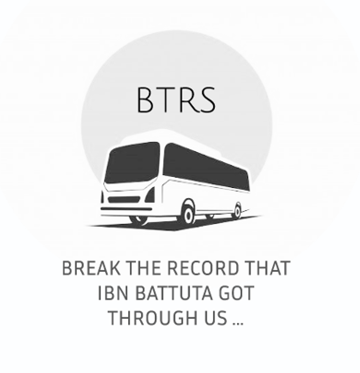

Slide 2
Done by
Team D
NOORAN ALKHATEEB - 202110370
ROAA ALMASARWEH - 202110779
HALA ALHAMAD - 202110416

Slide 3

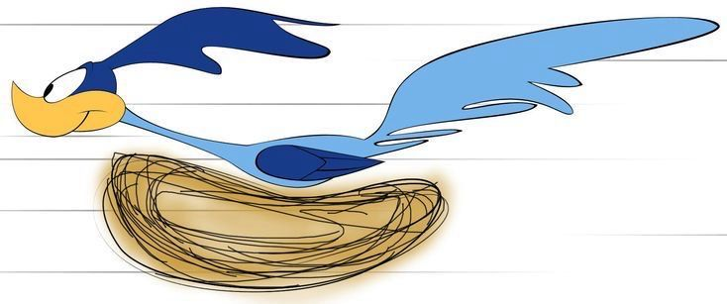
In these days , how many times you just wake up sooo late ? Then you decide to take a day off, then you remember that you will be fired for taking too many vacations
Since you aren’t Road-Runner; you don’t have any time to get to the bus location , check times , and find a bus and you need to find a way to save misfortune

Slide 4

BUT DON’T WORRY FROM NOW ON BECAUSE SUPERMAN HAS COME TO SAVE YOU

Slide 5
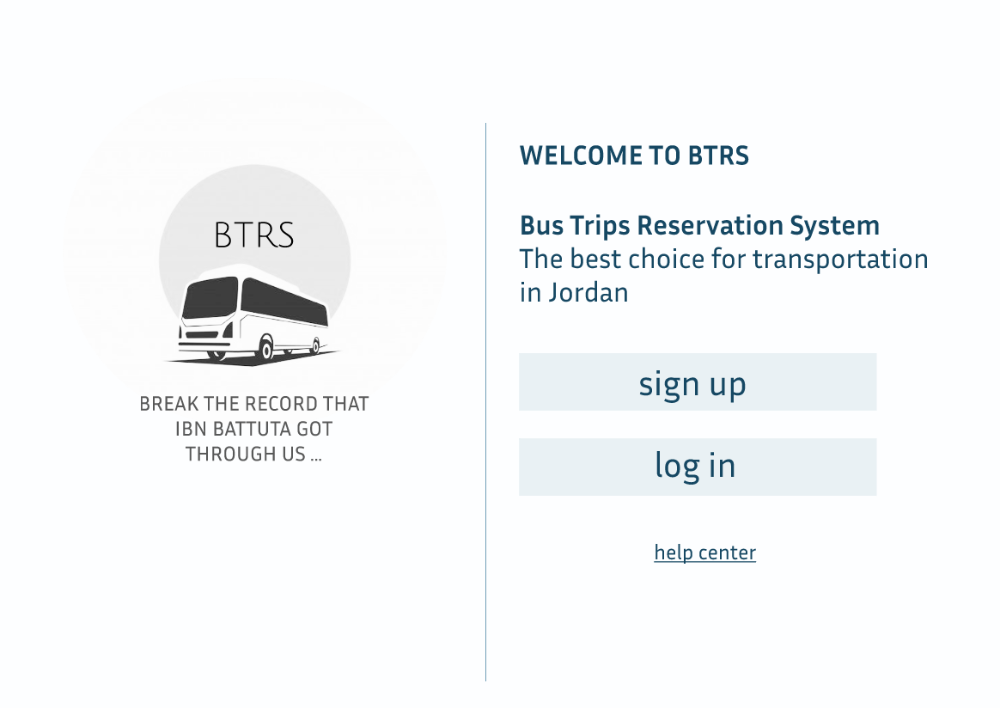
We present to you our #1 website in Jordan BRTS, which will save you the trouble of booking tickets forever.

Slide 6
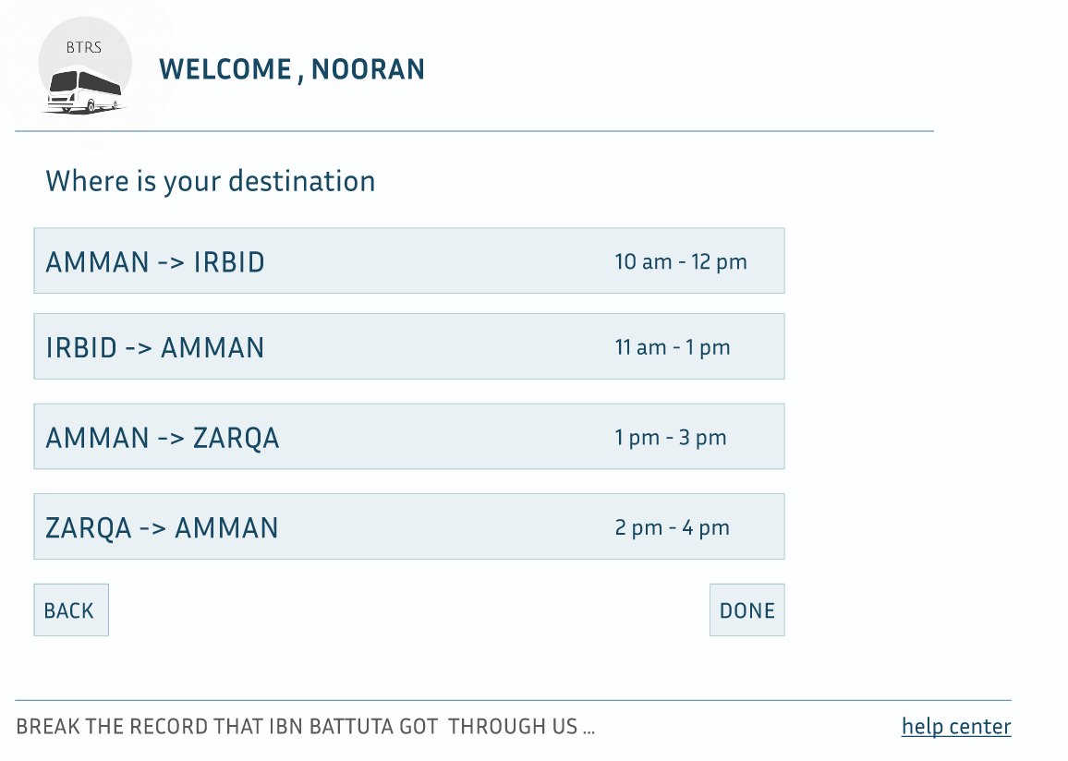
All you have to do is
create an account on our website,
and then the moment you complete the registration process,
you will go to the page for choosing the trip you want to book.

Slide 7
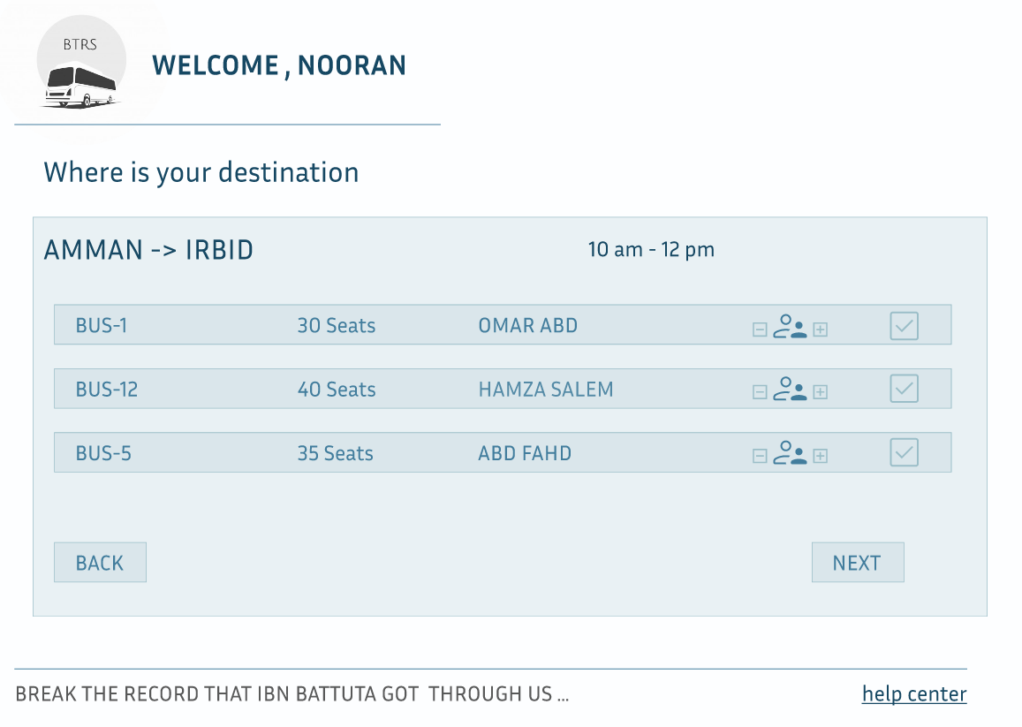
Not only that, in addition to that, you can choose the timing of the trip and the bus that you will ride, and we will provide you with information about the bus, such as the bus number, the name of the driver, and the number of passengers.

Slide 8
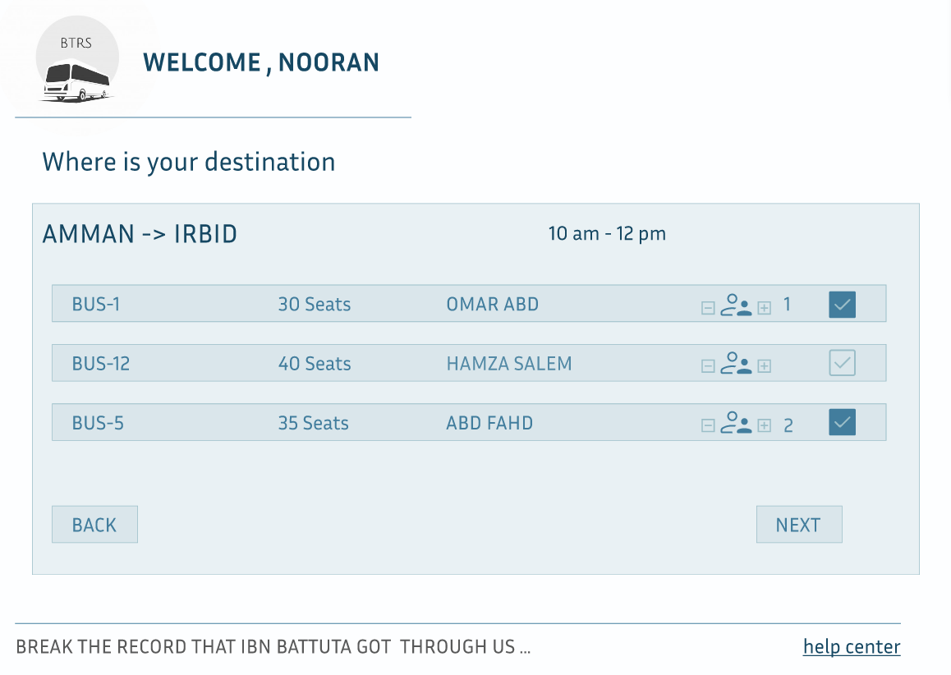
You can choose the number of buses and the number of seats you want, and you can modify your choice later

Slide 9
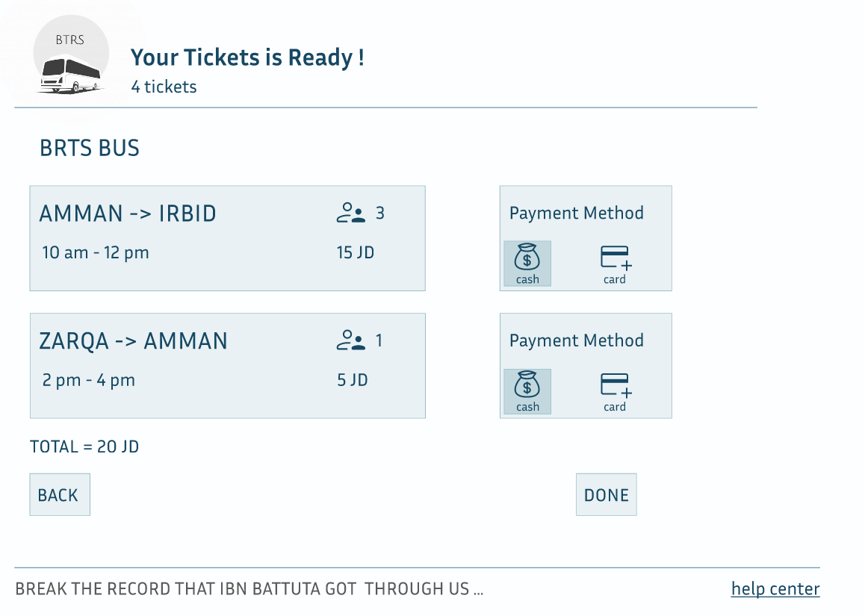
And you are free to choose whatever payment method you want

Slide 10

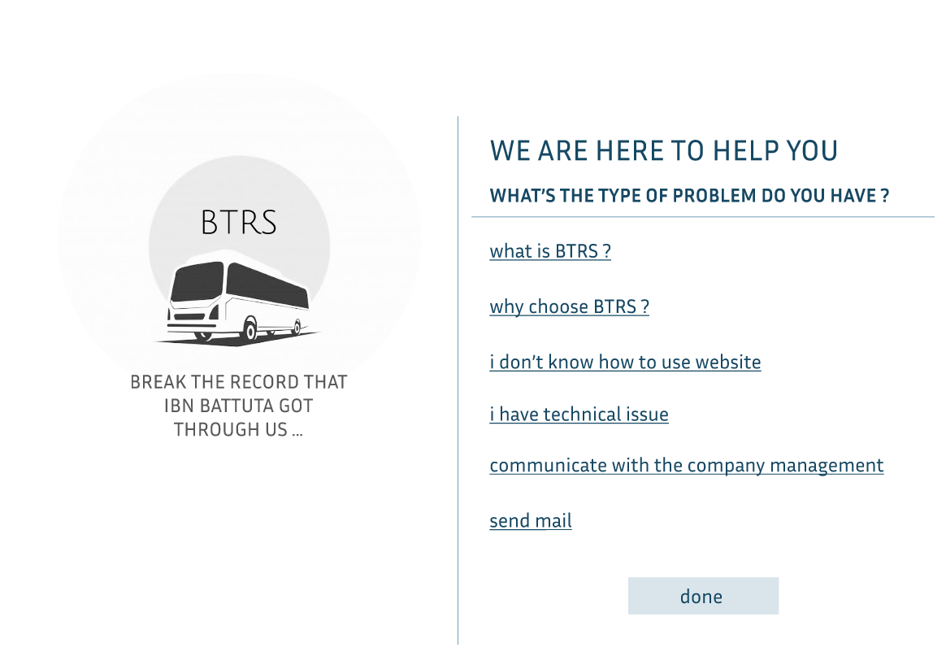
And don't worry, there is a help section that will save you if you have any kind of problem

Slide 11
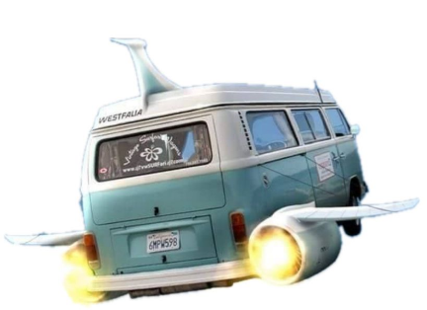
About future ?
We aspire to transform our vehicles into flying vehicles, and perhaps in the more distant future we can provide spacecraft to reach Mars faster

Slide 12

Just joking

Slide 13
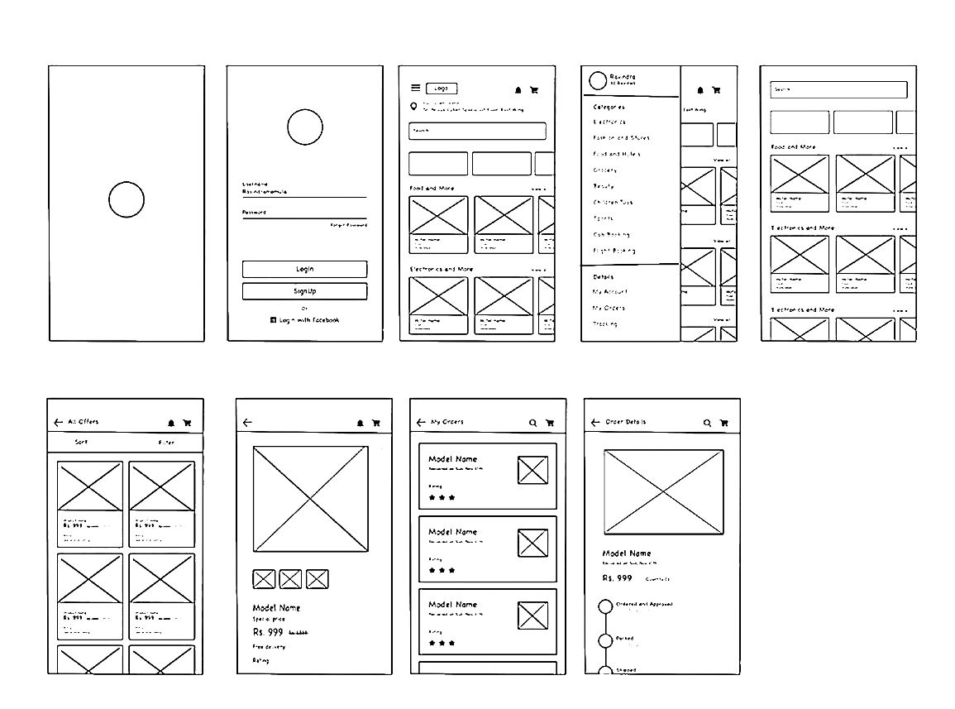
About future ?
We are thinking about adding some features to our website :-
We are thinking of creating an application next to the BRTS website to make our company present in all places and easier to use
We are thinking of creating a chat linking the driver and passenger to communicate better or solve any problem facing the passenger faster

Slide 14

About future ?
We are thinking about adding some features to our website :-
We are thinking about making a microphone system linked to artificial intelligence, so that the person provides his trip information through the microphone, and the details of the request will be displayed on a screen and audio to ensure its accuracy or if he wants to modify it.

Slide 15


The end , finito
Intro ✅
Problem ✅
Solution ✅
Dev process ✅
Suggestion for enhancement ✅
Now give us 3 marks please
Or more , why not

